Slide 1

Travel Savvy with Price Savvy
Shengqian Wang | Watson Wang
MUSA 5080 Public Policy Analysis | Forecast Airbnb Prices in Amsterdam
Notes:
Team
Project
Target & function - work as a plug-in of airbnb to improve and provide insight about price and choices

Slide 2
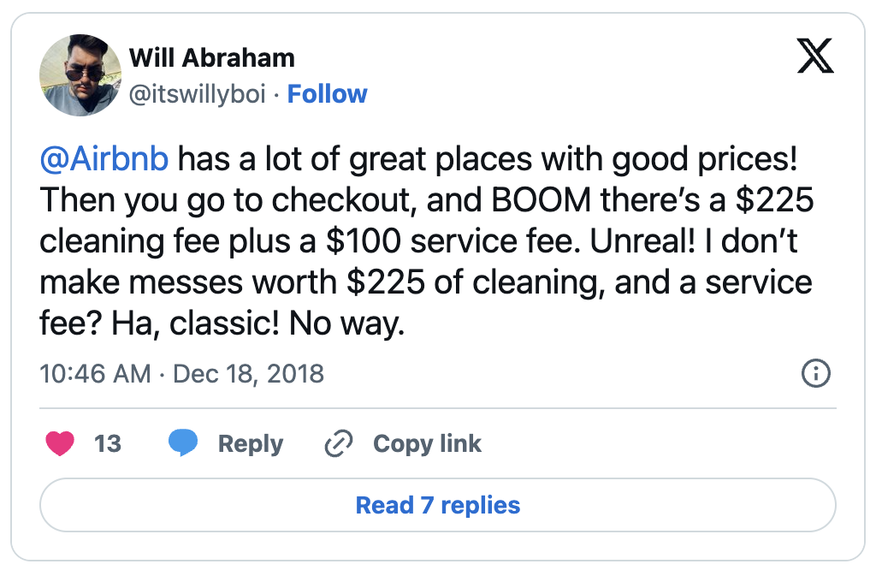
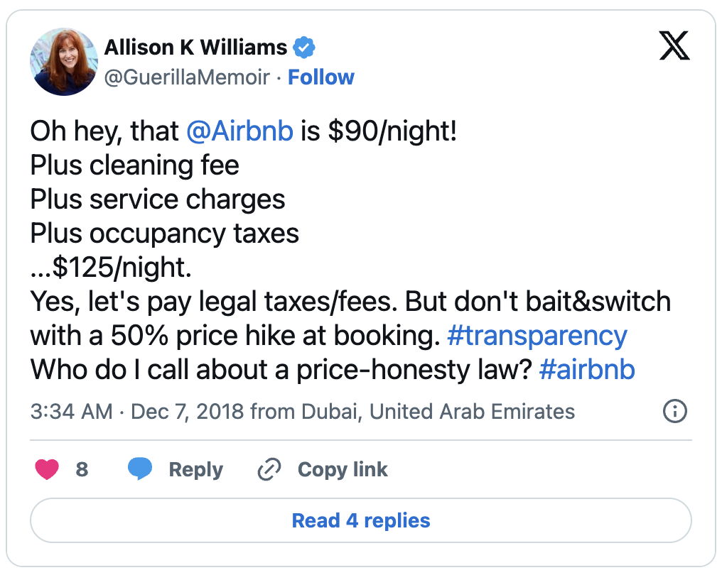
Low Price Transparency of Airbnb
Users lack a reference price for rent!
Notes:
We visualized the business as usual work flow and the new proposed work flow that can allow used to input moods and perfered date range to get a recommendation from this add-in

Slide 3

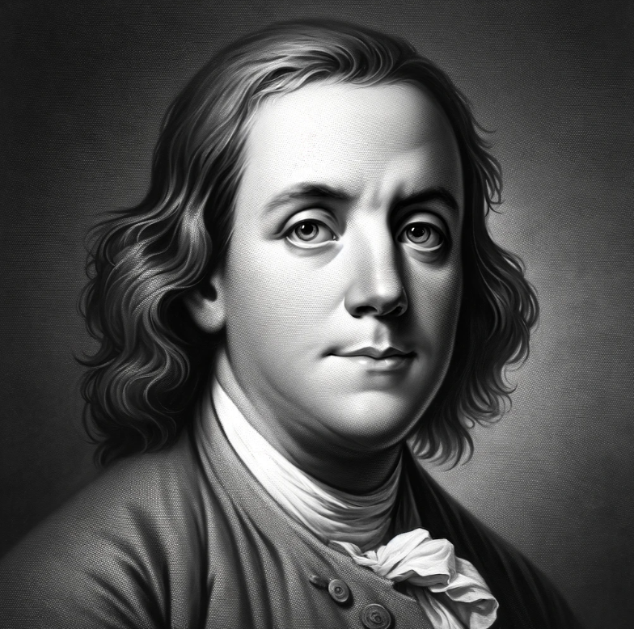
User Persona
Budget-savvy Franklin
“ I want to explore the world without breaking the bank. Every penny saved on travel is a penny I can use for my education.”
"Traveling on a shoestring doesn't mean skimping on experiences. It's about making smart choices that maximize every experience within my budget."
GOALS
BUY DECISION PROCESS
- To find affordable travel options during school breaks
- To experience different cultures and outdoor activities
- To manage travel and accommodation within a limited budget
- Researches extensively for the best deals
- Looks for student discounts and special offers
- Prefers booking through reliable platforms with good reviews
Age:
Gender:
Major:
Location:
Family Situation:
Archetype:
20 years old
Male
MUSA
Philly
Single
Resourceful Student Traveler
CHALLENGES, FEARS, PROBLEMS
VALUES
- Balancing the desire to travel with a tight budget
- Finding safe, affordable, and conveniently located accommodation
- Planning a trip that allows for cultural experiences without financial strain
- Loves to learn and experience new things
- Values financial savvy and smart spending
- Seeks adventure and personal growth through travel
SOLUTIONS
Trrendy offers affordable, reliable, and student-friendly travel options. With features like price alerts, discount aggregation, and safety ratings, Trrendy helps Ben plan his trips with confidence and ease.
Notes:
User Persona,
Targeting young – low budget% backpacker ^ impulse traveler
- Finding safe, affordable, and conveniently located accommodation based on moods and date selected

Slide 4
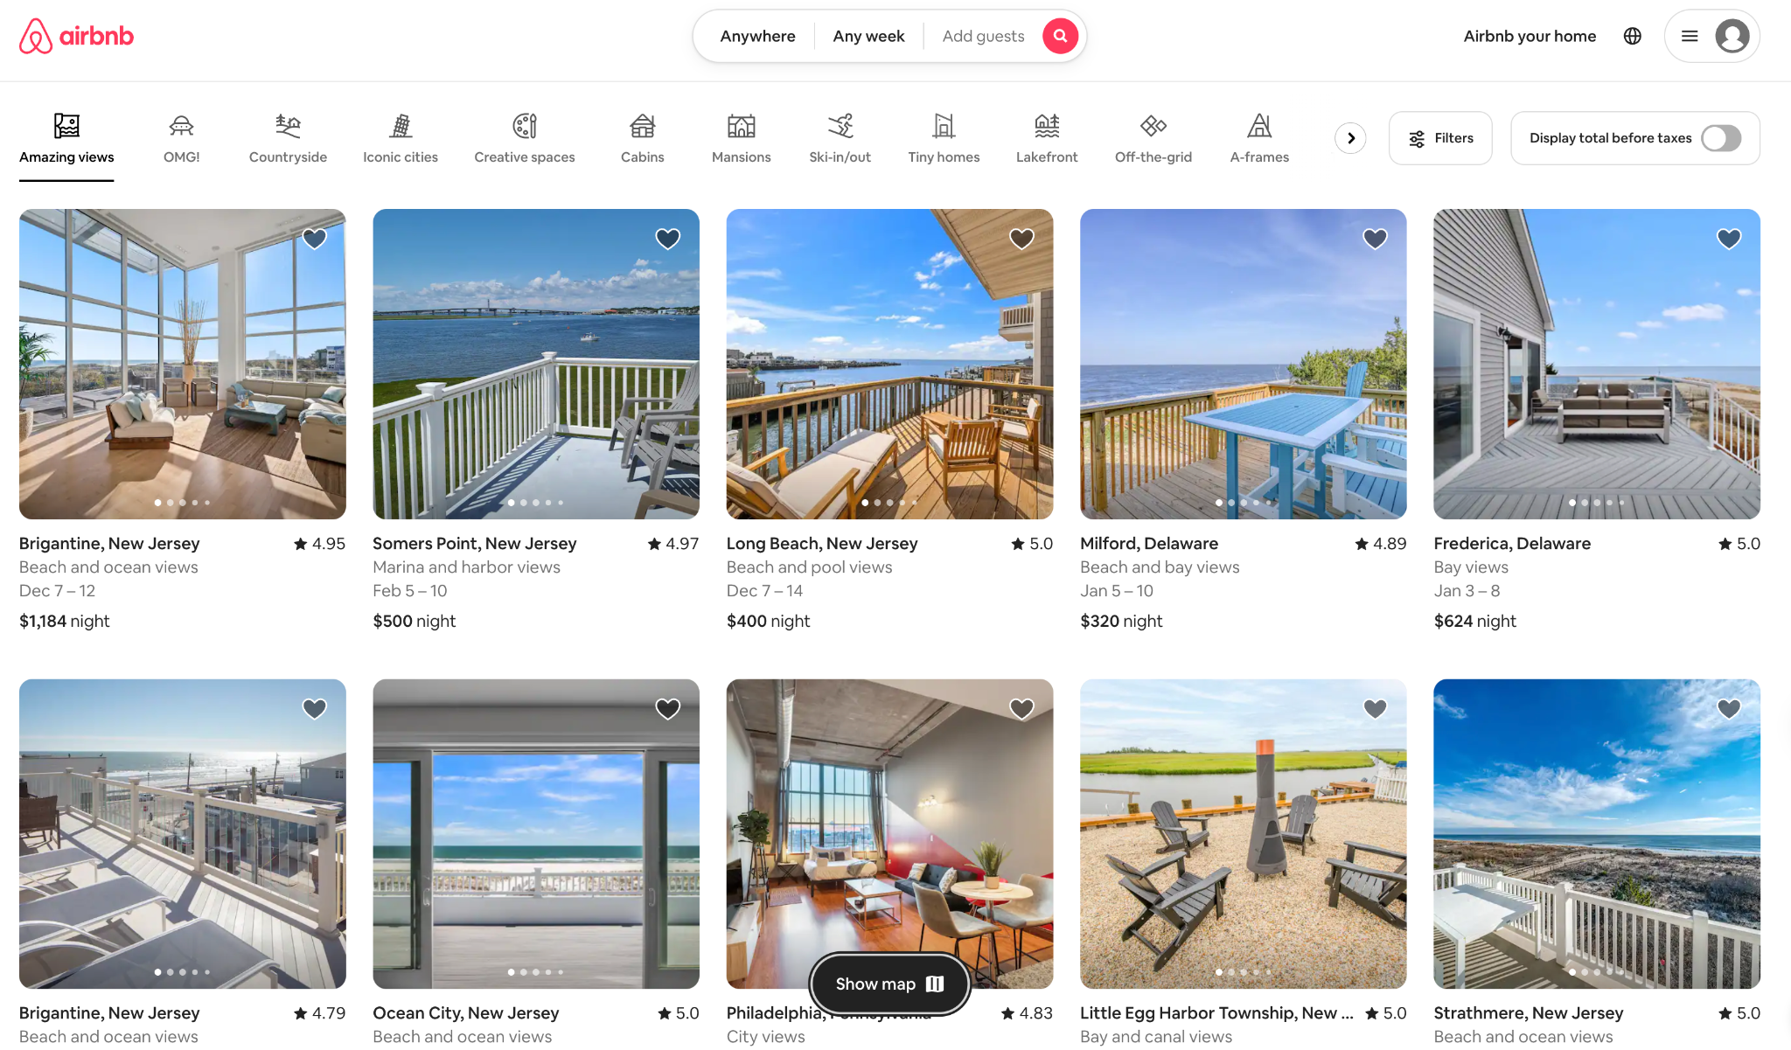
Inconvenient UI
Complex and underutilized filter
Lack of a price reference benchmark
Notes:
The quick search bar is super long and hard to use
Lack of price analysis and reference – do not know if a property worth
We do not know if it worth to try new hosts with few reviews

Slide 5
Trrendy Strategy
log in Airbnb
Search
make decision
Business as Usual
log in Airbnb
Search
input info to tool
compare price
make decision
Trrendy Tools
original steps
added steps from our tool
Notes:
We visualized the business as usual work flow and the new proposed work flow that can allow used to input moods and perfered date range to get a recommendation from this add-in

Slide 6
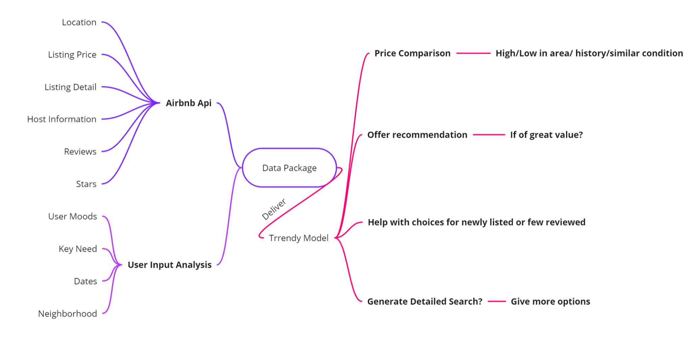
Trrendy Work Flow
Notes:
Stepping to the work flow of our product, it collect data from both Airbnb api but also use inputs like moods dates, and key needs. Aftr delievering this datapackage to model, your expected to get price comparison, recommendation based on search results, help with choices for newly / few reviewed places

Slide 7
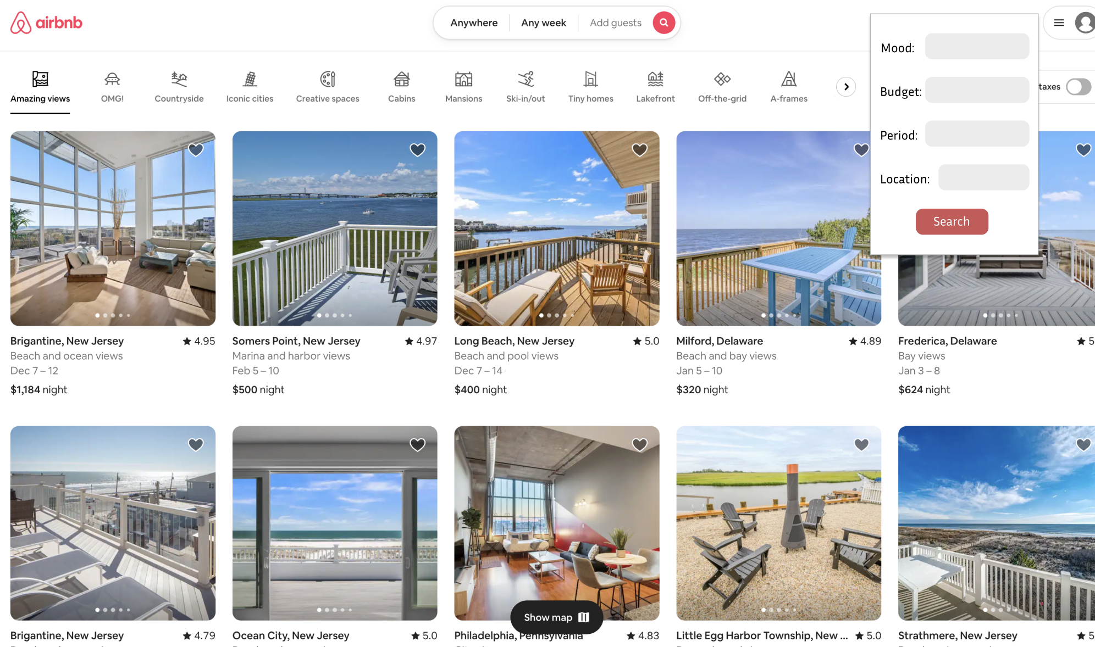
New UI --> Input Info
input basic preference
Notes:
Here is a proposed ui of our model – it mostly works as a paid plug-in for Airbnb. Your able to input your mood budget, period, and location/community prefered

Slide 8
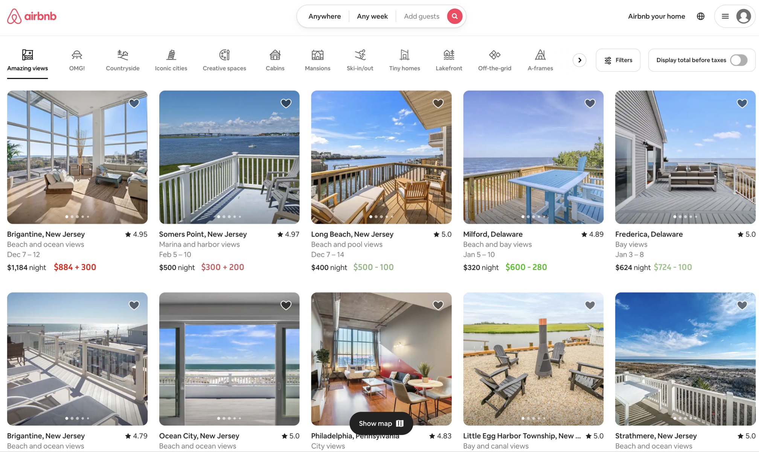
New UI --> Show Suggested Price
show predicted price and residule

Slide 9
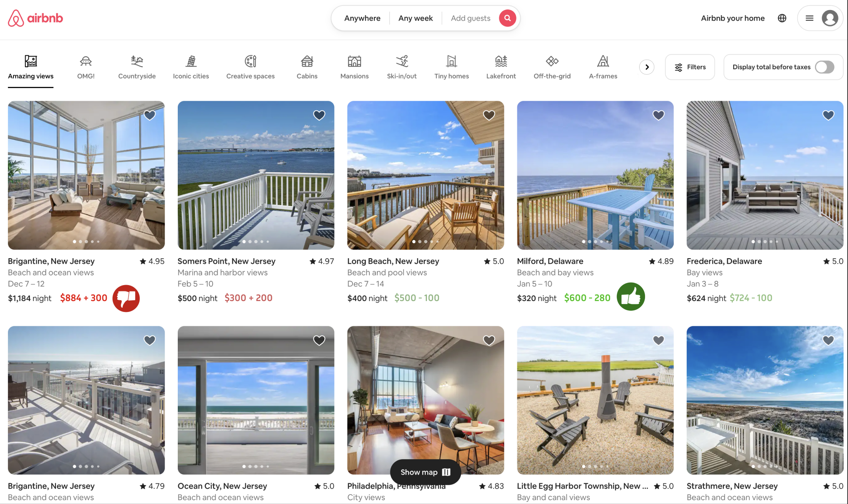
New UI --> Give Direct Recommendation
give recommendation

Slide 10
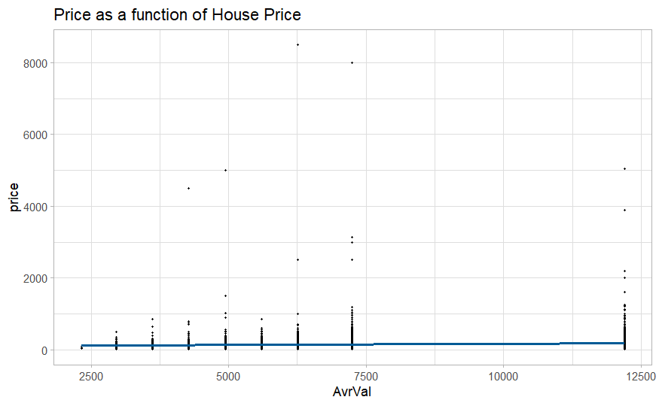
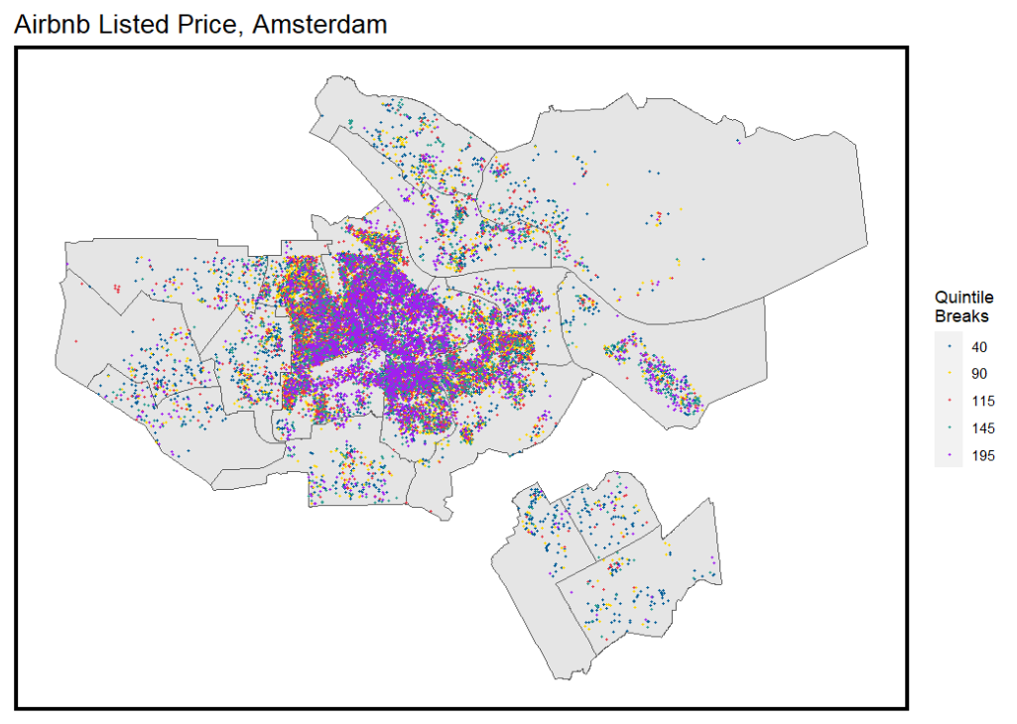
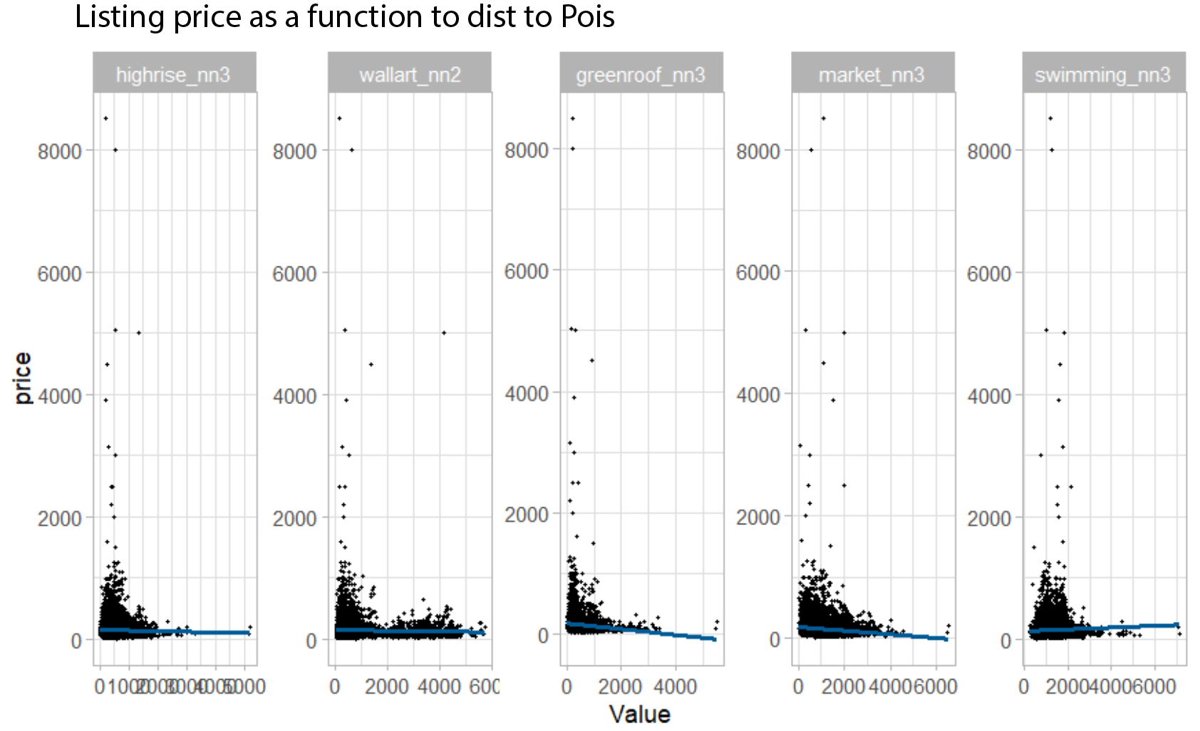
Exploratory Data Analysis
Notes:
We are at a early stage of modeling process, here are some of the outcomes - we played with data like the housing value and distance to POIs, and worked based on this insights

Slide 11
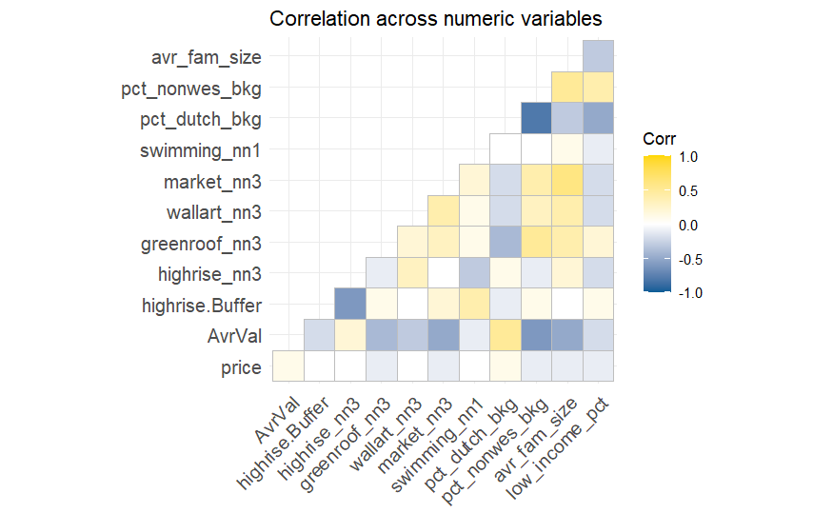
Data Correlation
Notes:
Here is a correlation plots of our current model – the current data is not good enough to study about the listing prices. But we are engaging more data from Ams Gis port , CBS census and listing details.

Slide 12
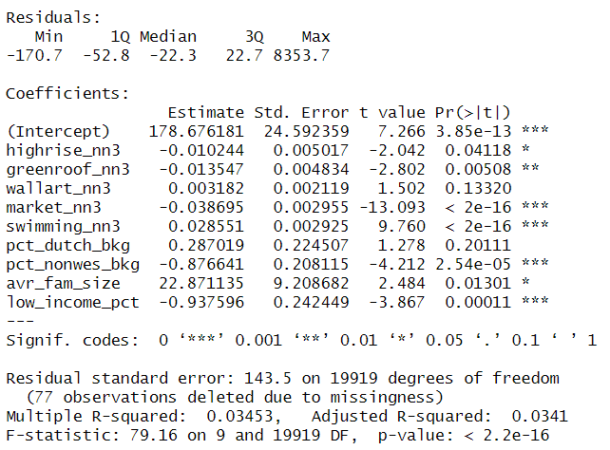
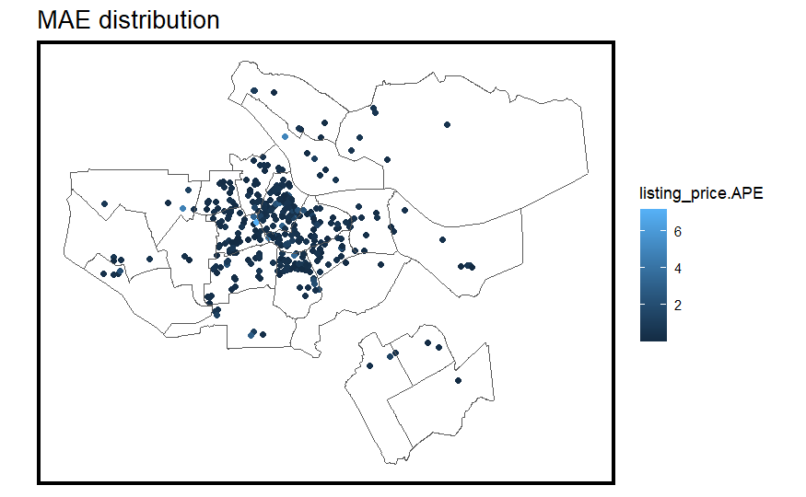
Baseline Model
Notes:
Here is a basic performance of our model – the prediction error and R square score reflected are not yet well developed. We will embad more data and add another indicator other than price to better connect with the user side.

Slide 13




Travel Savvy with Price Savvy
Data-driven
suggested
price
Convenient filter system
Iterative
suggest
algorithm
Friendly
user Interface

Slide 14
Next Step
Utilizing NLTK to process Review Data
Engage with more property-related data from Detailed Listing Data
Engage with more environment hazard data
Develop a alternative Factor from Review Score and Listing Price to serve for Users

